Slide 1
Baseball Catcher Project
Team 10
Jason Lund and Michael Hinton

Slide 2
Initial Baseball Detection Algorithm
Set small ROI around baseball pitcher
Use GaussianBlur and threshold on the absdiff of two adjacent frames
Calculate the mean of the binary output for both left and right camera
If the mean for both left and right camera exceeds some constant threshold, trigger ball tracking algorithm
Set image for background subtraction

Slide 3
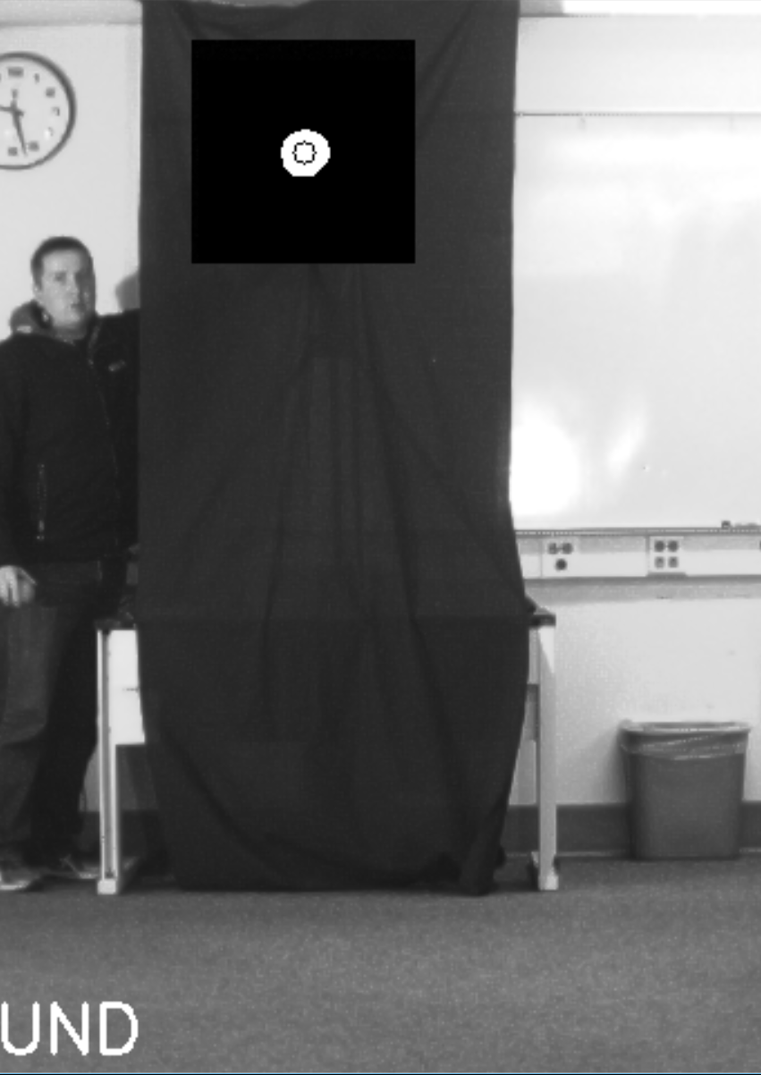
Baseball Tracking Algorithm
Use GaussianBlur and threshold on the absdiff of the current frame and the initial background frame.
Use findContours on left and right ROI. If a contour is found, we assume it is the ball.
We update the ROI to follow the center of the ball if possible.
We only look at the first 10 images once triggered.
Error reduction:
We calculate the centroid and area of the ball. If too dissimilar, we throw out the data point.
Reset Catcher
After 10 frames with no contours found or 100 frames since triggered, we reset.

Slide 4
Projectile Trajectory Algorithm

Slide 5

Projectile Trajectory Algorithm

Slide 6
Other Features

